Slide 1
貸款申請人信用風險危機預警模型之建立
第三組
109703008 | 楊皓丞
109703043 | 陳芸
109703006 | 王世揚
109305082 | 戴士瑋
109703036 | 池田美和

Slide 2

E-Signing of Loan
-Based on Financial History
The dataset contains applicant details who are willing to complete e-signing of loan process.
The goal is to build various different algorithms & predict whether applicant completed e-signing of loan process or not.

Slide 3

Dataset
Dataset：E-Signing of Loan-Based on Financial History | Kaggle
Entry_id—User Identifier - client
age—Age of user
pay_schedule—How often applicants get paid（weekly, bi-weekly）
home_owner—0:- Rented home 1:- Owner
income—Applicant income
months_employed—How many months he is doing job
years_employed—How many years he is doing job
current_address_year—How many years a person stayed at current address

Slide 4
Dataset
personal_account_m—How many months that person had a personal account
personal_account_y—How many year that person had a personal account
has_debt—1 if the applicant has an outstanding debt, 0 otherwise
amount_requested—amount the user has applied for
risk_score—risk score / risk score 2 / risk score 3 / risk score 4 / risk score 5 — there are the five risk scores given by the internal teams
ext quality score / ext quality score 2 — these are the two risk scores we get from external teams

Slide 5
Dataset
inquiries_last_month—how many times the applicant had a hard check on their credit score
e-signed—1 indicates that the applicant has completed the e-singing process, 0 otherwise. This the target variable.
Entry_id
categorical variables
Variables
Features
continuous variables
e-signed

Slide 6
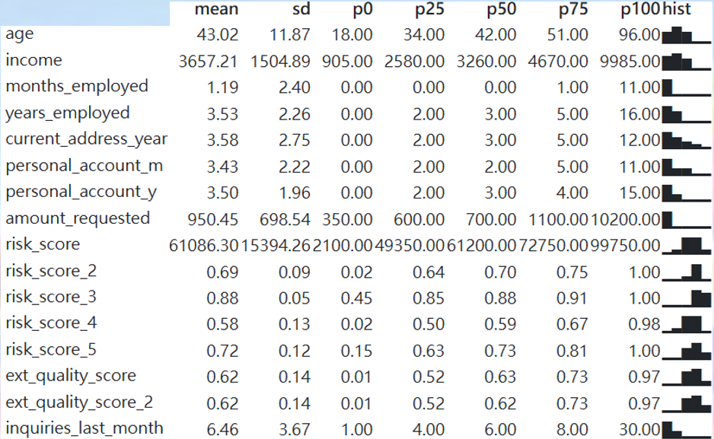
Exploratory Data Analysis
Number of rows 17908

Slide 7
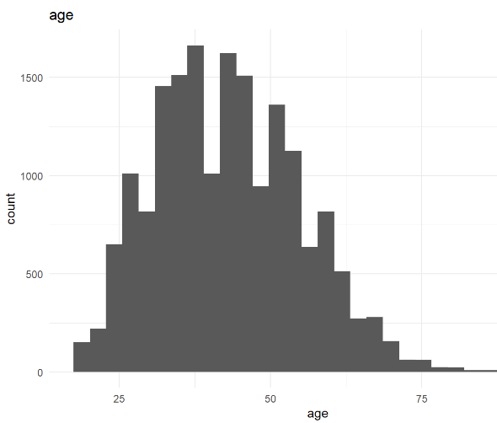
Exploratory Data Analysis
age histogram
Notes:
客戶的年齡

Slide 8
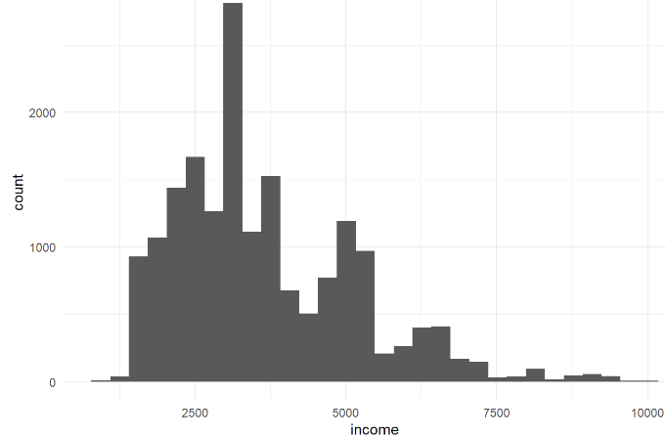
Exploratory Data Analysis
income histogram

Slide 9
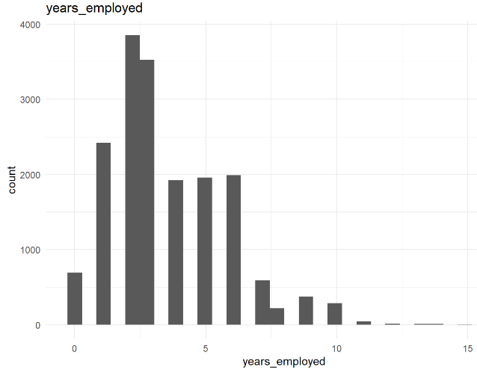
Exploratory Data Analysis
years_employed bar chart

Slide 10
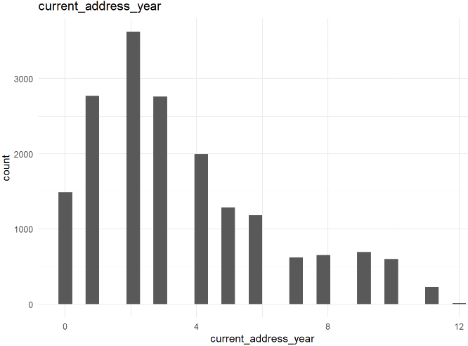
Exploratory Data Analysis
current_address_year bar chart

Slide 11
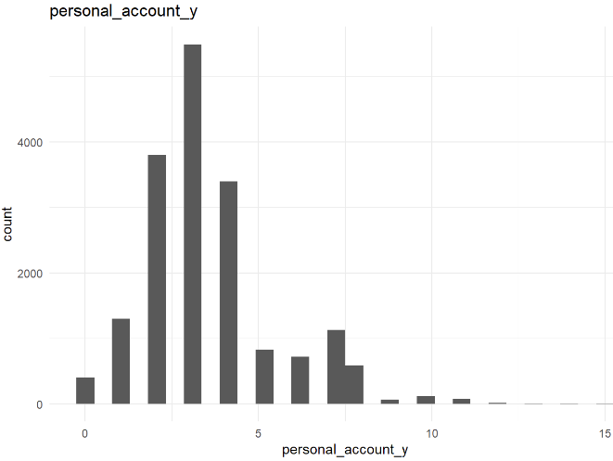
Exploratory Data Analysis
personal_account_y bar chart

Slide 12
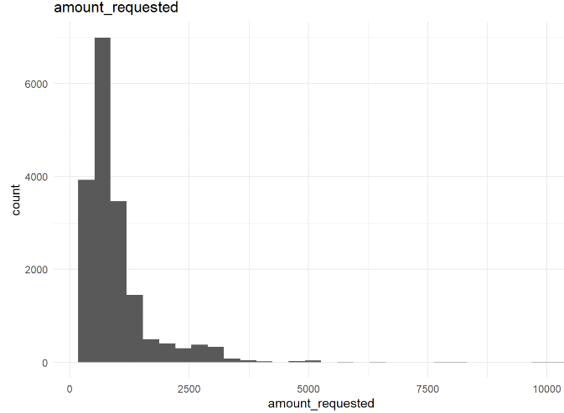
Exploratory Data Analysis
amount_requested histogram

Slide 13
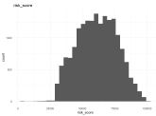
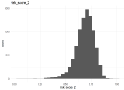
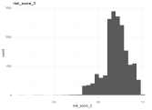
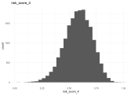
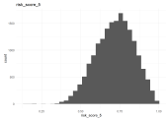
Exploratory Data Analysis
risk_score histogram
risk_score
risk_score_2
risk_score_3
risk_score_4
risk_score_5

Slide 14
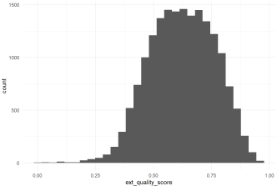
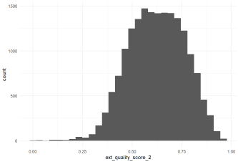
Exploratory Data Analysis
ext_quality_score histogram
ext_quality_score
ext_quality_score_2

Slide 15
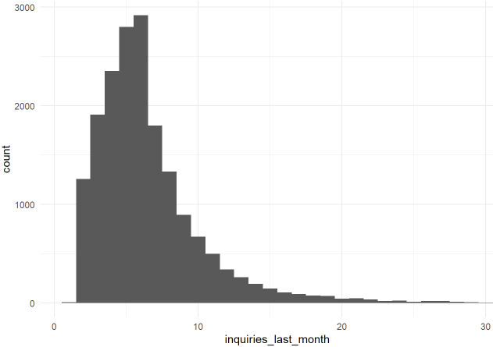
Exploratory Data Analysis
inquiries_last_month bar chart

Slide 16
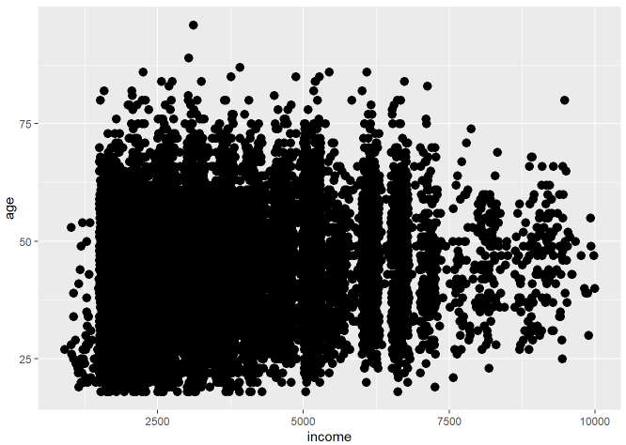
Exploratory Data Analysis
Income/age scatterplot

Slide 17
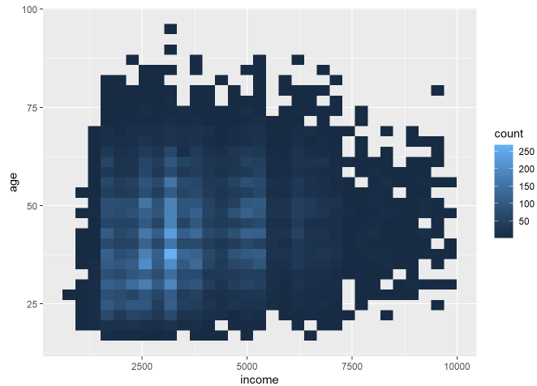
Exploratory Data Analysis
Income/age Hexbin

Slide 18
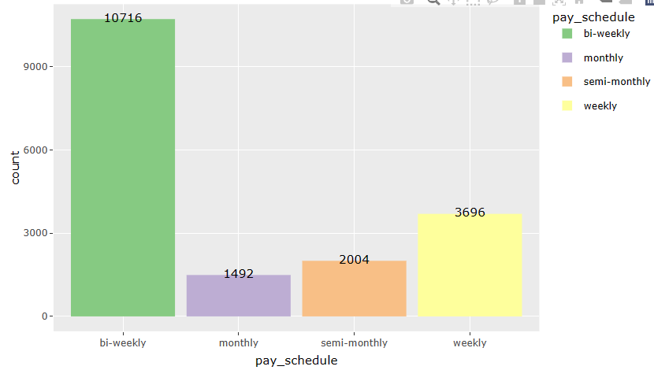
Exploratory Data Analysis
pay_schedule bar chart

Slide 19
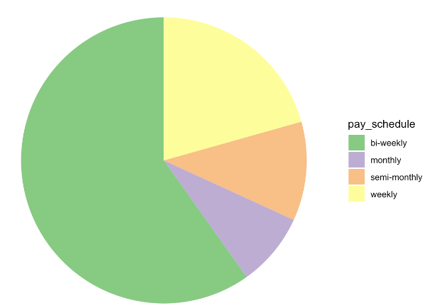
Exploratory Data Analysis
pay_schedule pie chart

Slide 20
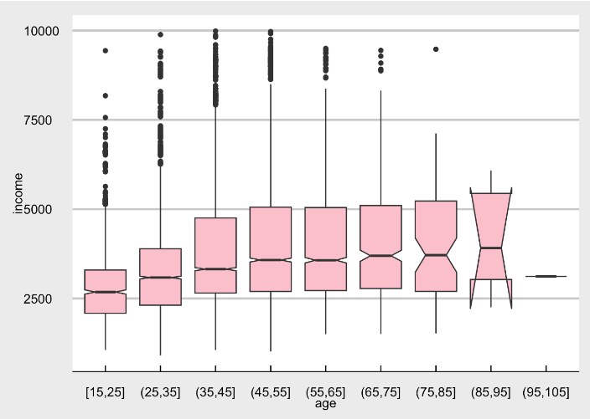
Exploratory Data Analysis
age/ income boxplot

Slide 21
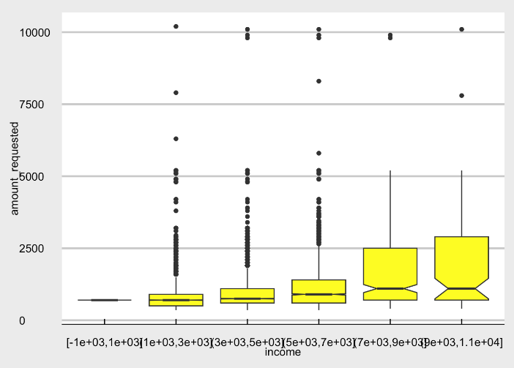
Exploratory Data Analysis
income/amount_requested boxplot

Slide 22
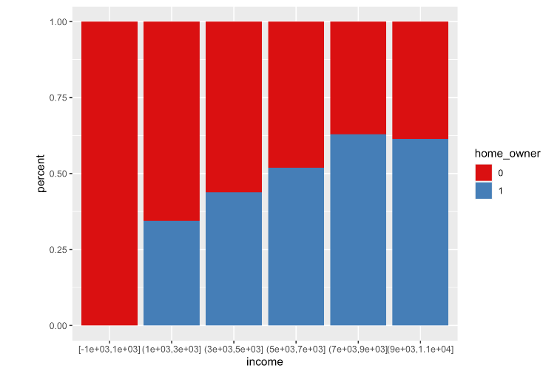
Exploratory Data Analysis
Income/home_owner percent bar chart

Slide 23
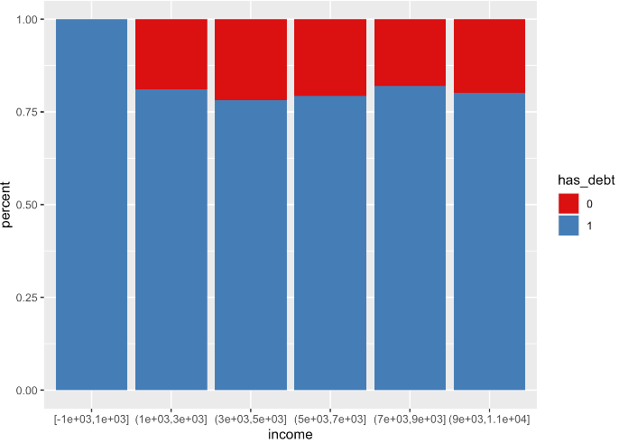
Exploratory Data Analysis
Income/has_debt percent bar chart

Slide 24
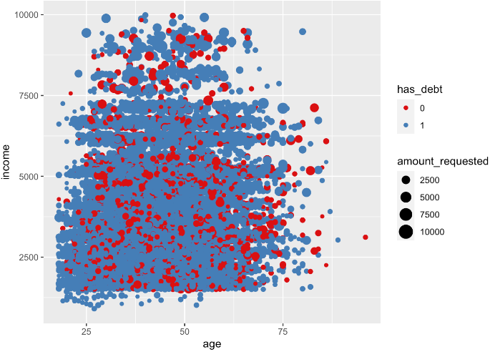
Exploratory Data Analysis
age/income/has_debt/amount_requested scatterplot

Slide 25
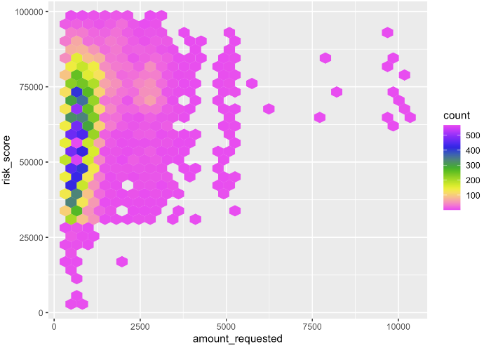
Exploratory Data Analysis
amount_requested/risk_score hexbin

Slide 26
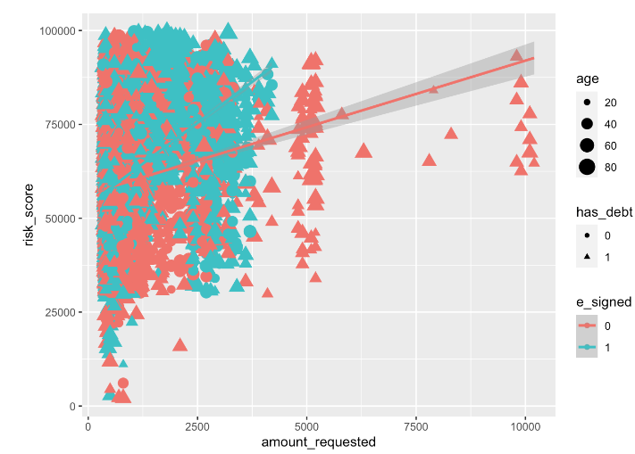
Exploratory Data Analysis
amount_requested/risk_score/has_debt/age/e_signed scatterplot

Slide 27
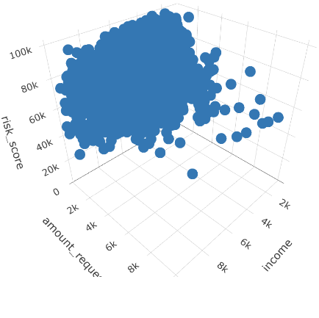
Exploratory Data Analysis
income/amount_requested/risk_score 3d scatterplot

Slide 28
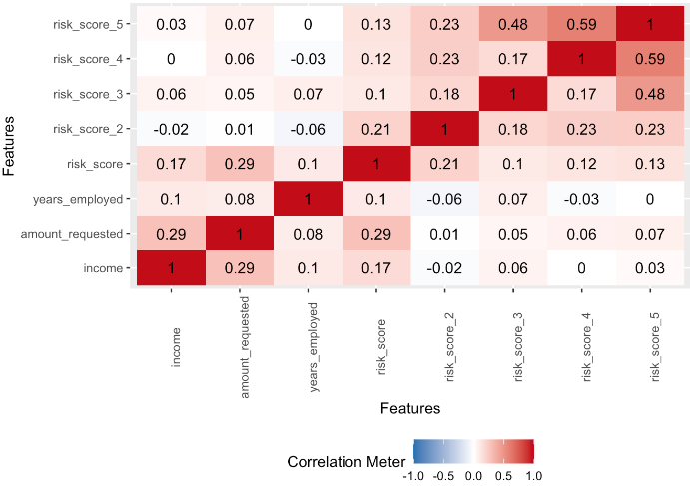
Exploratory Data Analysis
income, amount_requested, years_employed, risk_score, risk_score_2, risk_score_3, risk_score_4, risk_score_5 correlation

Slide 29
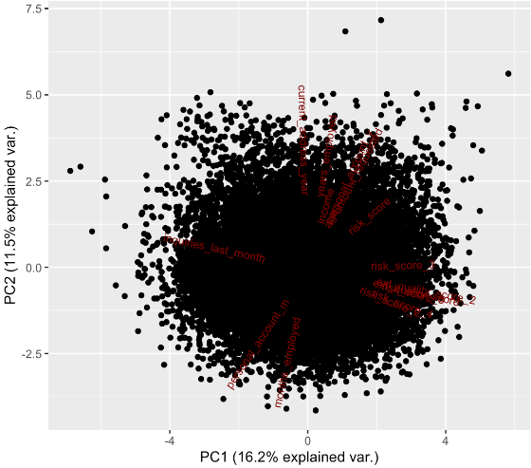
Exploratory Data Analysis
principal component analysis

Slide 30
Classification Models
Decision Tree
Random Forest
Bagging
Adaboost
Logistic
Regression
Neural Network
Support Vector Machine
K Nearest Neighbor
XGBoost

Slide 31
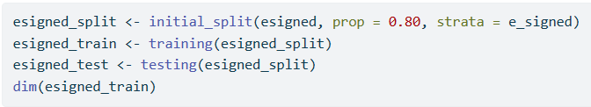
Splitting the dataset
Dataset
17908
Train Dataset
80%
14326
Test Dataset
20%
3582

Slide 32
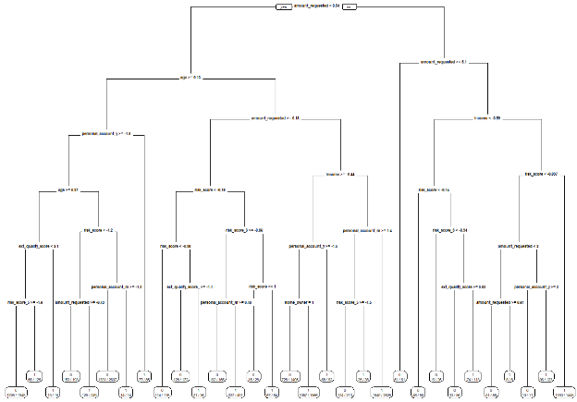
Decision Tree Model

Slide 33
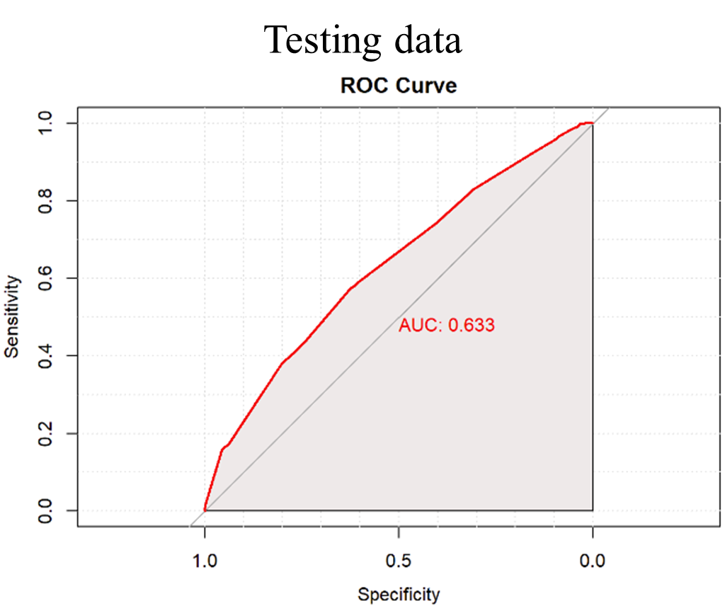
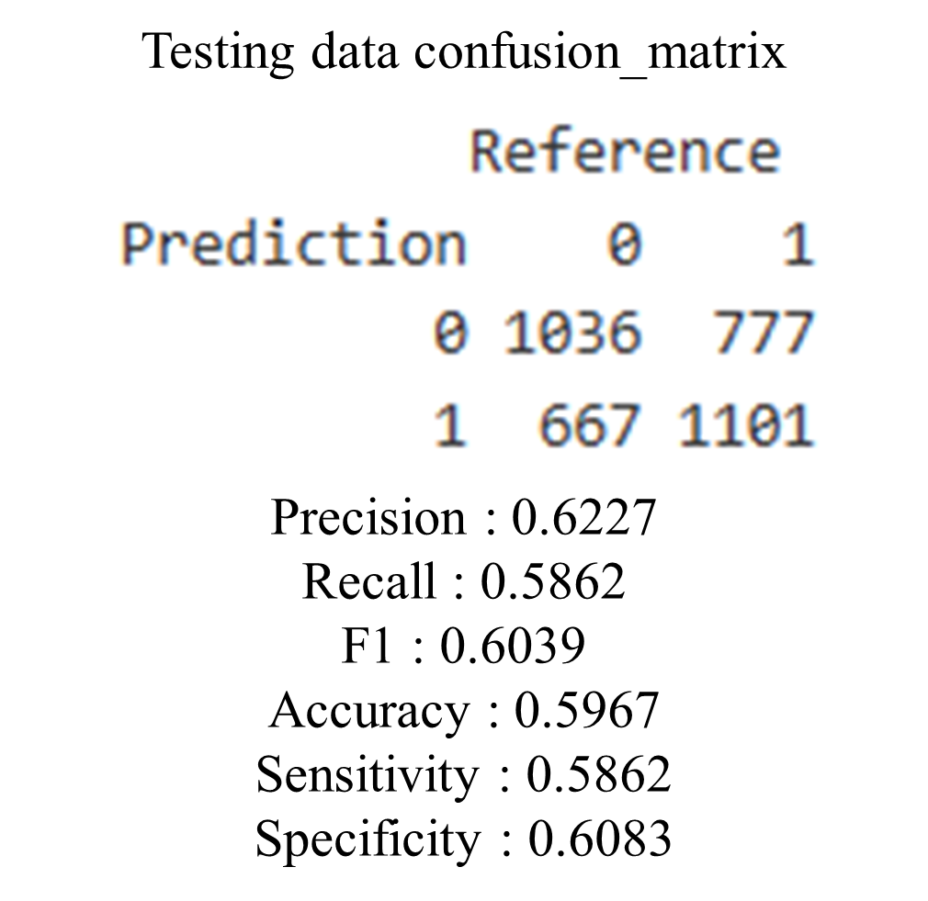
Decision Tree Model

Slide 34
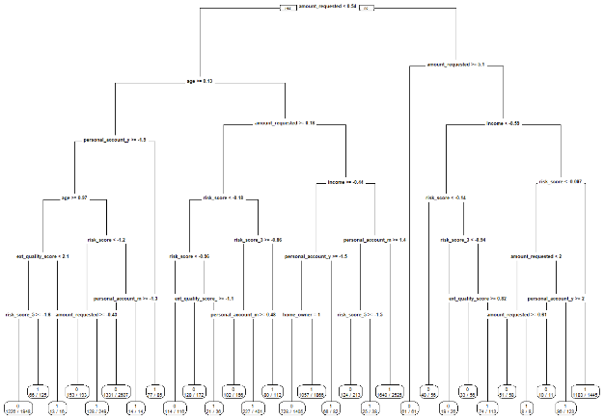
Decision Tree Model­­—Prune

Slide 35

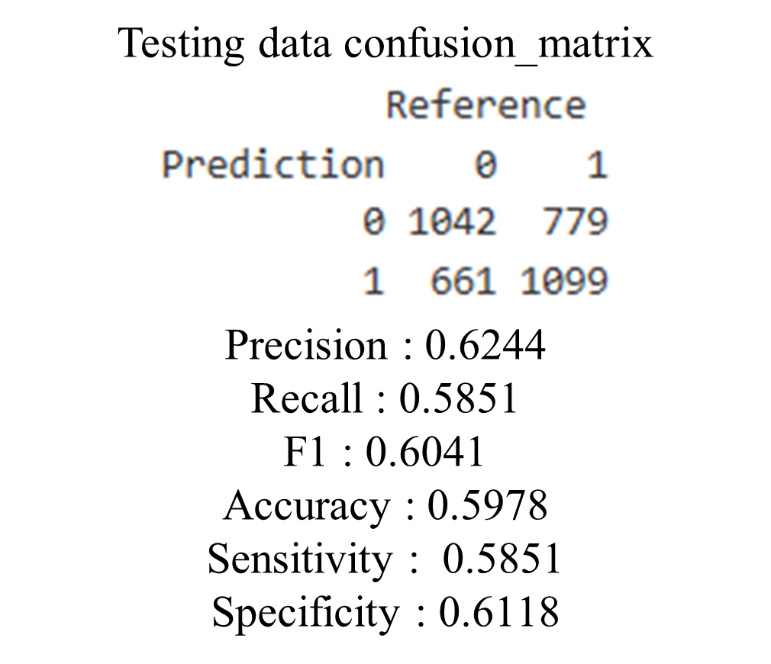
Decision Tree Model­­—Prune

Slide 36
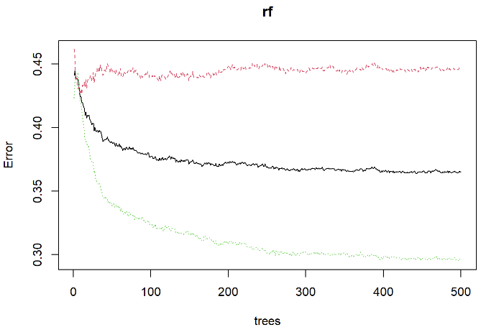
Random Forest Model

Slide 37
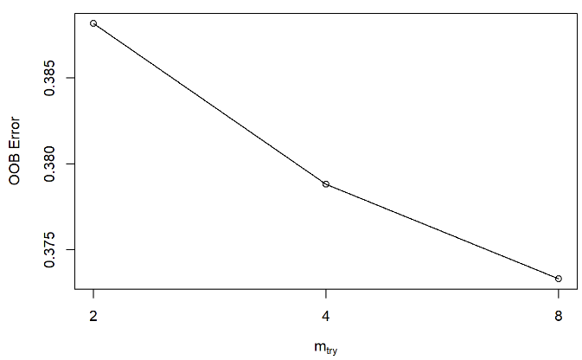
Random Forest Model

Slide 38
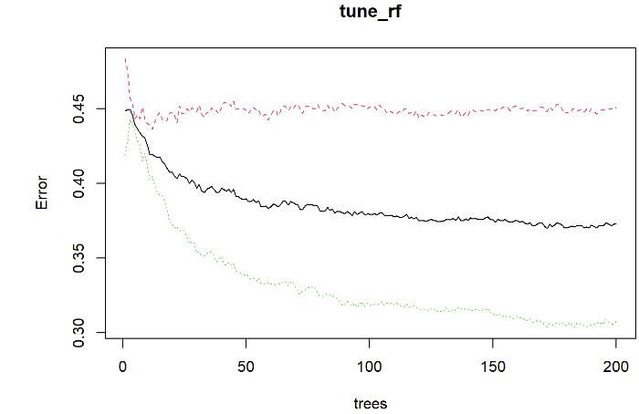
Random Forest Model

Slide 39
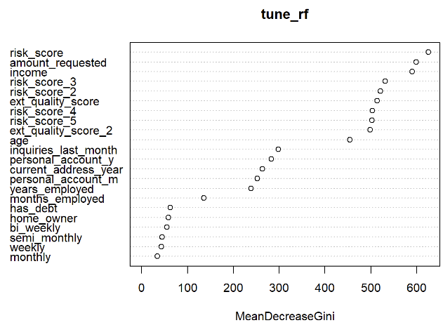
Random Forest Model
important variables : risk_score, amount_requested, income
tune random forest

Slide 40
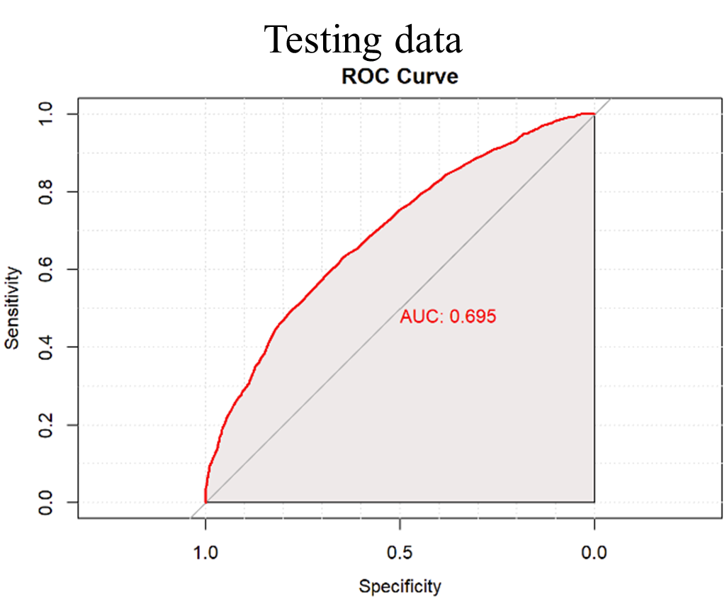
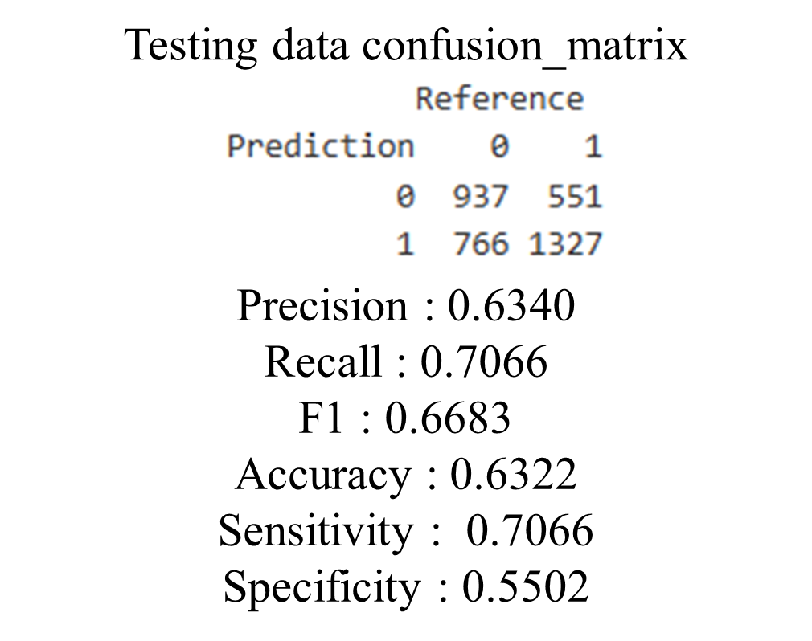
Random Forest Model

Slide 41
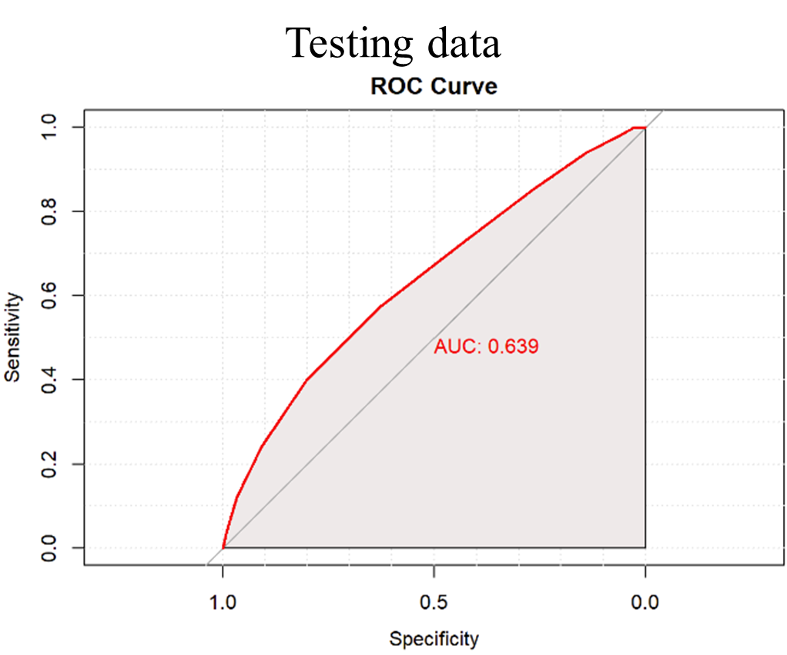
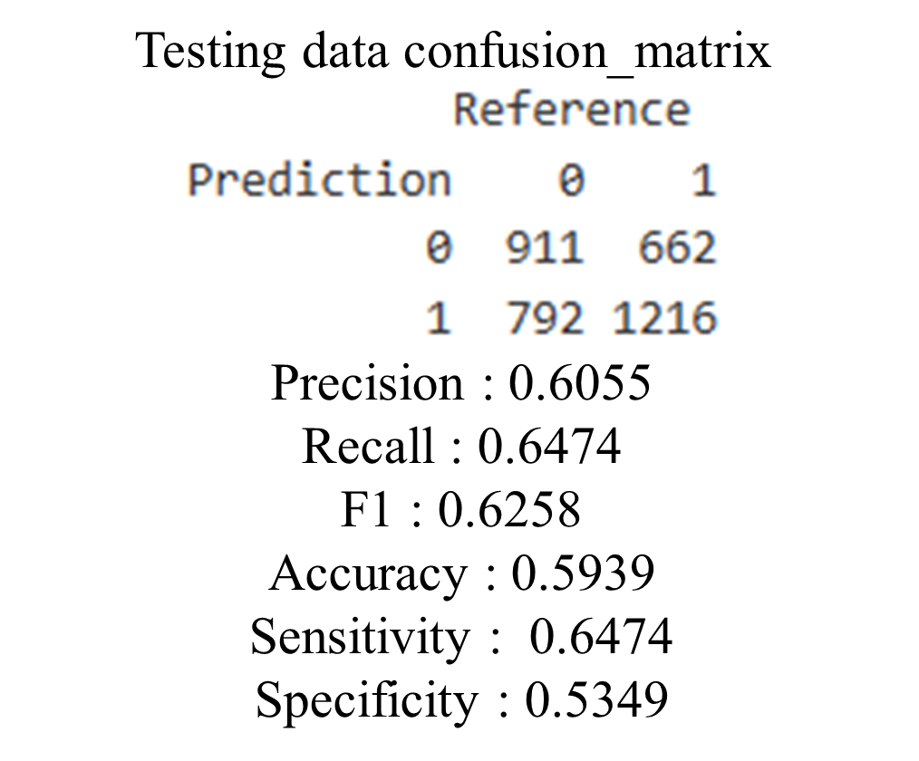
Bagging (Bootstrap aggregating)

Slide 42
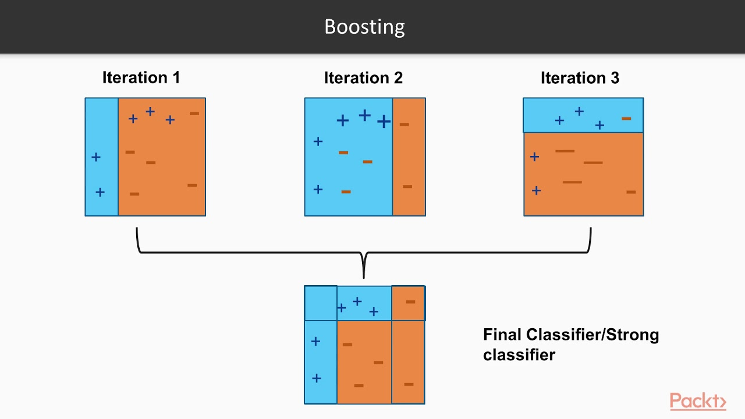
Adaboost（Adaptive Boosting）

Slide 43
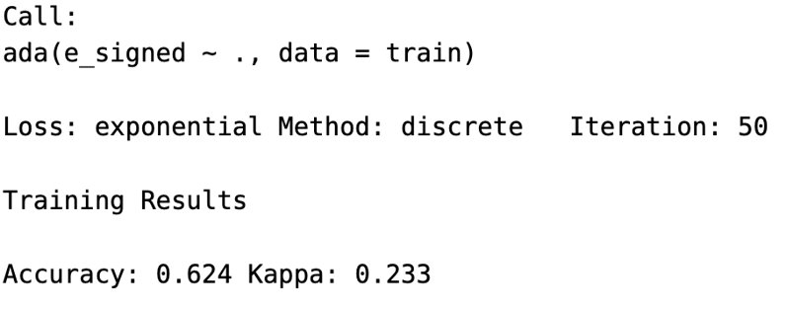
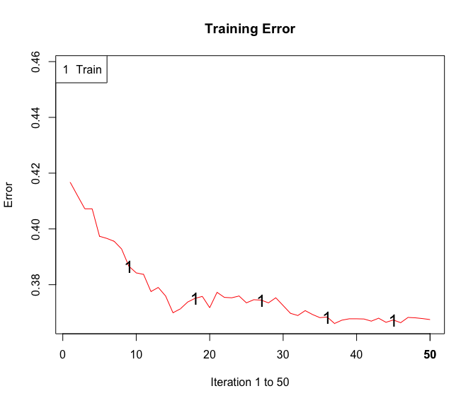
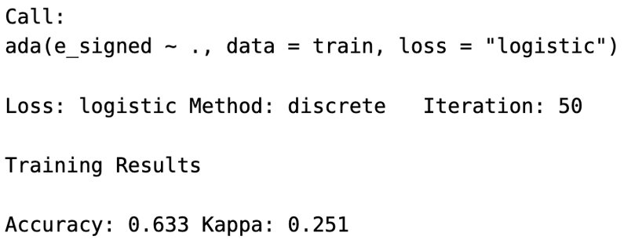
Adaboost（Adaptive Boosting）

Slide 44
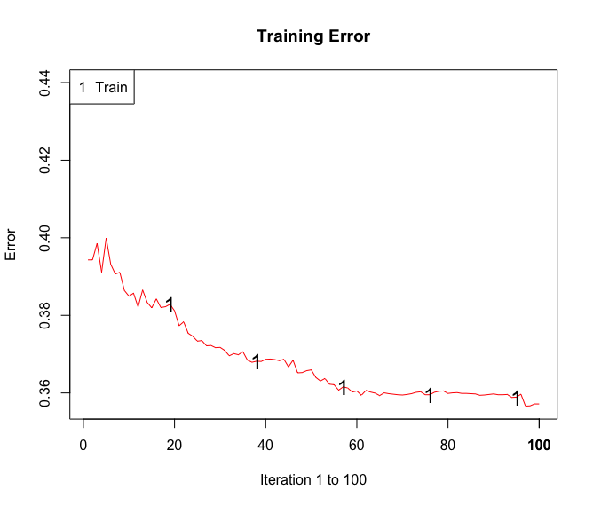
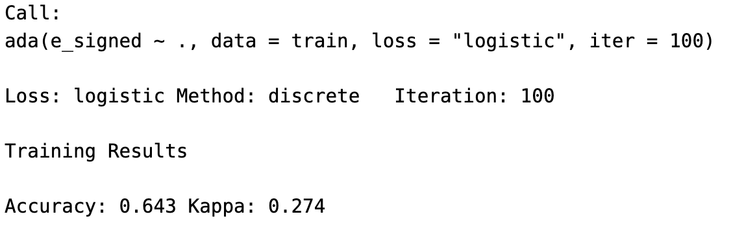
Adaboost（Adaptive Boosting）

Slide 45
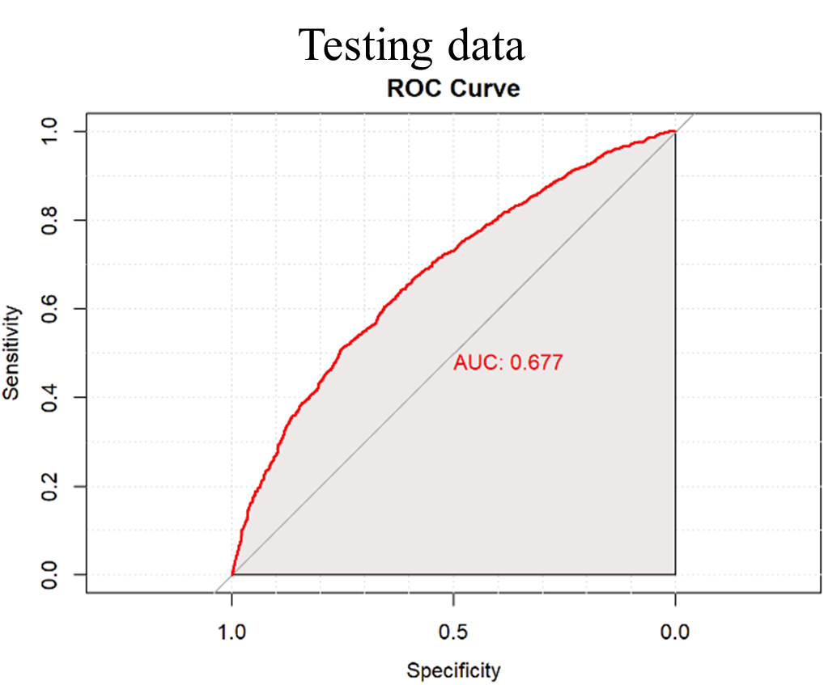

Adaboost（Adaptive Boosting）

Slide 46


Logistic Regression Model

Slide 47

Dense Neural Network Model

Slide 48


Dense Neural Network Model

Slide 49


Dense Neural Network Model

Slide 50

Support Vector Machine Model
Use parsnip package in tidymodels ecosystem to write svm specification, and set kernel function to rbf.

Slide 51


Support Vector Machine Model

Slide 52


Support Vector Machine Model

Slide 53


K Nearest Neighbors
Overfitting

Slide 54


K Nearest Neighbors

Slide 55


XGBoost(eXtreme Gradient Boosting)

Slide 56


XGBoost(eXtreme Gradient Boosting)

Slide 57

XGBoost(eXtreme Gradient Boosting)

Slide 58


Models Accuracy Comparison
Testing data

Slide 59


Hyperparameter tuning the best model Grid Search—XGBoost
This code is using tidymodels packages
tree_depth | trees
5 | 10
5 | 200
10 | 10
10 | 200
20 | 10
20 | 200
Set tree_depth and trees to be tuned
Use 10-fold cross vaildation
Set hyperparameter to the best by accuracy

Slide 60


Hyperparameter tuning the best model Grid Search—XGBoost

Slide 61


Hyperparameter tuning the best model Grid Search—XGBoost

Slide 62

XGBoost Data Pre-processing — using recipe package

Slide 63


XGBoost Data Pre-processing — using recipe package

Slide 64


XGBoost Data Pre-processing — using recipe package

Slide 65

XGBoost — Feature Engineering — Regularization LASSO
This code is using recipeselectors packages

Slide 66


XGBoost — Feature Engineering — Regularization LASSO
LASSO used to perform both feature selection and regularization.
Regularization penalizes large coefficients and force many coefficients to become 0.
Overfitting

Slide 67


XGBoost — Feature Engineering — Regularization LASSO

Slide 68

XGBoost — Feature Engineering — MRMR (Minimum Redundancy and Maximum Relevance)
This code is using recipeselectors packages

Slide 69


XGBoost — Feature Engineering — MRMR (Minimum Redundancy and Maximum Relevance)
Score features based on their relevance to the labels but with minimum relevance to other features.

Slide 70


XGBoost — Feature Engineering — MRMR (Minimum Redundancy and Maximum Relevance)

Slide 71

Final Model

Slide 72
Transparent Approaches & Opaque Approaches
Decision Tree
Transparent
Random Forest
Logistic Regression
Model
Neural Network
Opaque
Support Vector Machine
K Nearest Neighbors

Slide 73
Conclusion
Based on the analysis of the e-signing of loan using machine learning models and neural network , the XGBoost classifier was found to be the best performing model.
Incorporating explainability methods, such as SHAP values, can help to better understand the factors that influence loan approval decisions.

Slide 74
Bibliography
An Introduction to Statistical Learning with Applications in R, Gareth James, Daniela Witten , Trevor Hastie, Robert Tibshirani, Springer, 2013.
Artificial Intelligence-A Modern Approach, Fourth Edition, Stuart J. Russell and Peter Norvig, Pearson Education, 2021.
Data Mining —Practical Machine Learning Tools and Techniques, Fourth Edition, Ian H. Witten, Eibe Frank, Mark A. Hall, Christopher J. Pal, Elsevier, 2017.
Data Mining with R -Learning with Case Studies, Luís Torgo, Chapman & Hall, CRC, 2011.
Data Science for Business, Foster Provost and Tom Fawcett, O’Reilly Media, 2013.
Dive into Deep Learning, Aston Zhang, Zachary C. Lipton, Mu Li, and Alexander J. Smola
Hands-on Machine Learning with Scikit-Learn, Keras, and TensorFlow Concepts, Tools, and Techniques to Build Intelligent Systems, SECOND EDITION, Aurélien Géron, O’Reilly Media, 2019.

Slide 75
Bibliography
Introduction to Data Science, Hui Lin and Ming Li.
Introduction to Machine Learning, Third Edition, Ethem Alpaydın, 2014, Massachusetts Institute of Technology.
Introduction to Statistical Machine Learning, Masashi Sugiyama, Elsevier ,2016.
Machine Learning with R, Brett Lantz, Packt ,2013.
Mathematics for Machine Learning ,Marc Peter Deisenroth, A. Aldo Faisal, and Cheng Soon Ong, Cambridge University Press, 2020.
MATLAB Deep Learning-With Machine Learning, Neural Networks and Artificial Intelligence, Phil Kim, 2017.
Practical Data Science with R , NINA ZUMEL, JOHN MOUNT, Manning, 2014.
Tidy Modeling with R: A Framework for Modeling in the Tidyverse 1st Edition, Max Kuhn, Julia Silge, O'Reilly Media, Inc, 2022
https://ithelp.ithome.com.tw/articles/10201916

